Slide 1
Governmental Relations at I Am Boundless Inc.
Presented By: Anthony Kukura, Director of Governmental Affairs

Slide 2
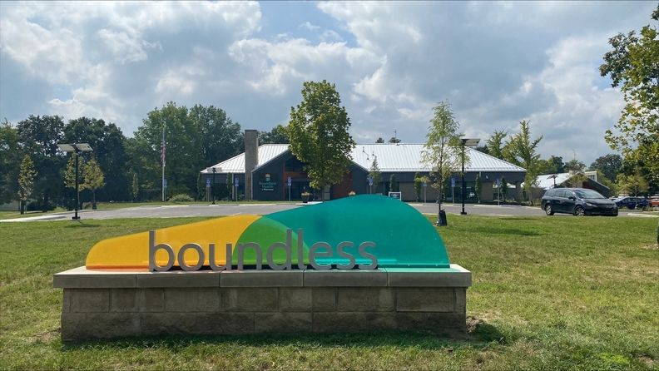
About I Am Boundless Inc.
Boundless is a 501c3 nonprofit organization based here in Worthington
One of the five largest health and human services (HHS) organization's based in Ohio
Services provided to nearly 7000 individuals in 77 of Ohio's counties
3200 Employees
Primarily Medicaid funded (88% of our annual budget)
Often seen as an innovator in our field which can be seen through our numerous service lines (IDD residential care, adult day services, transportation, behavioral healthcare, nursing, primary care, dental, youth services, etc.)
Services are provided to both adults and children
"Building a world that realizes the boundless potential of all people."
Notes:
Founded in 1980 as Franklin County Residential Services, Boundless has grown from a modest, centralized organization into a dynamic family of nonprofits engaged with I/DD and behavioral health communities across the state. From residential support and vocational habilitation to primary care and behavioral health, our approach to whole-person care celebrates each individual and empowers them to become active participants in the communities where they live, work, and play.

Slide 3
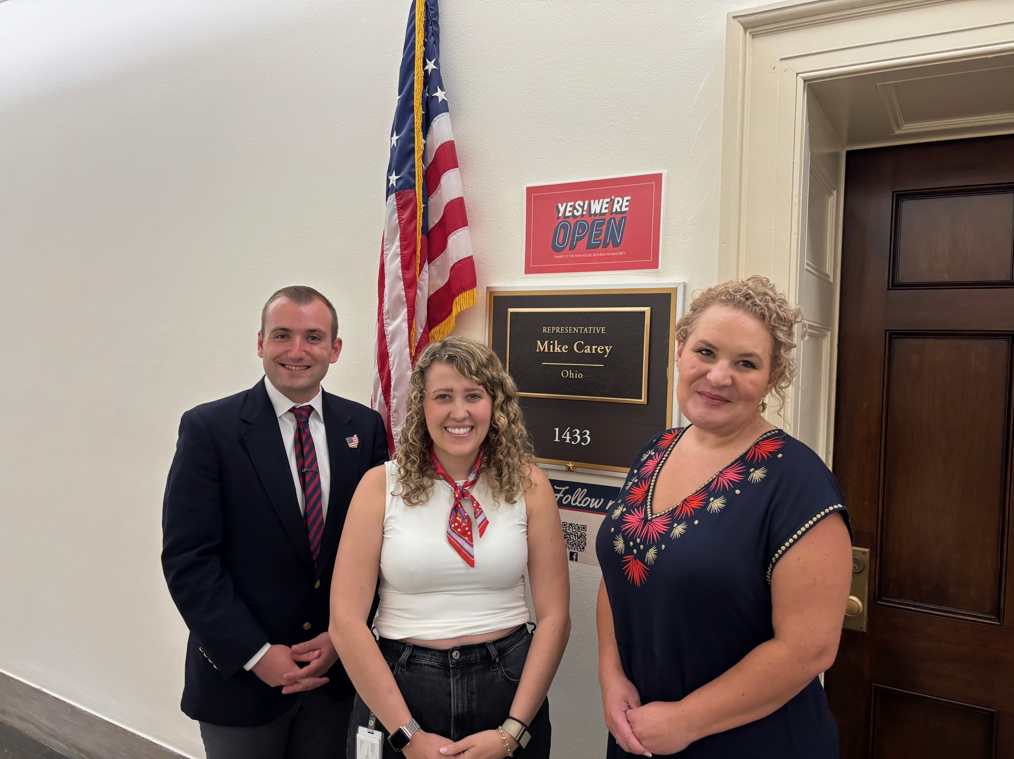
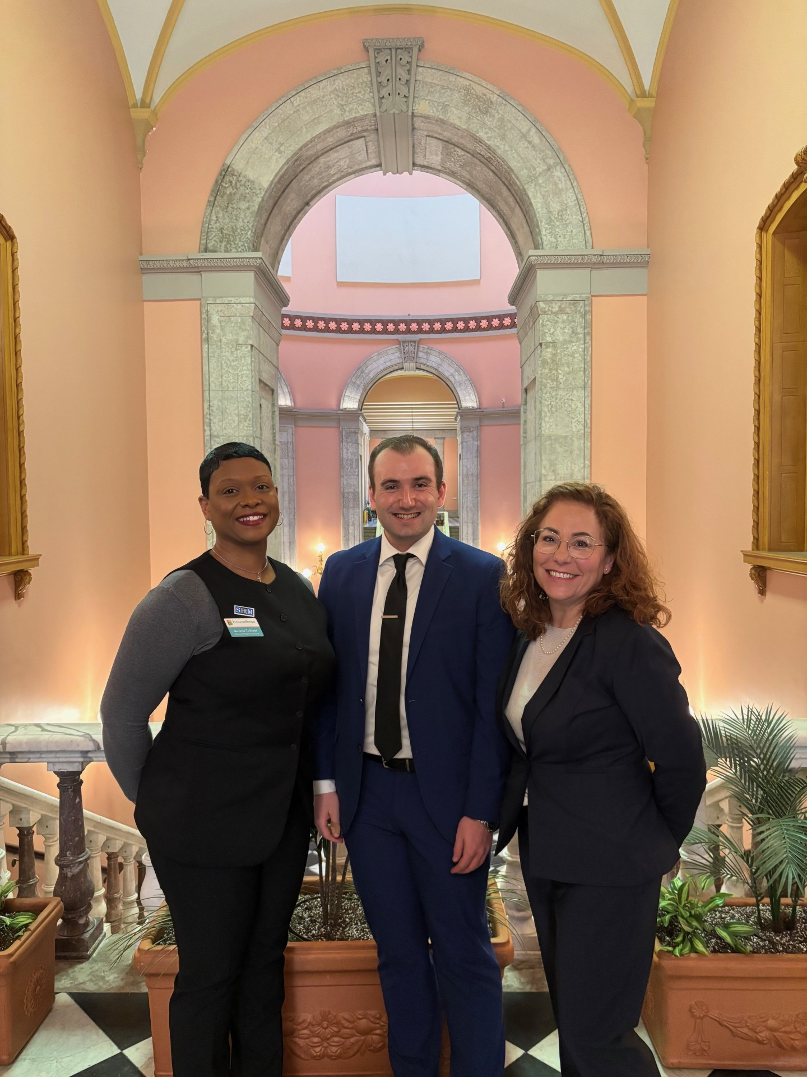
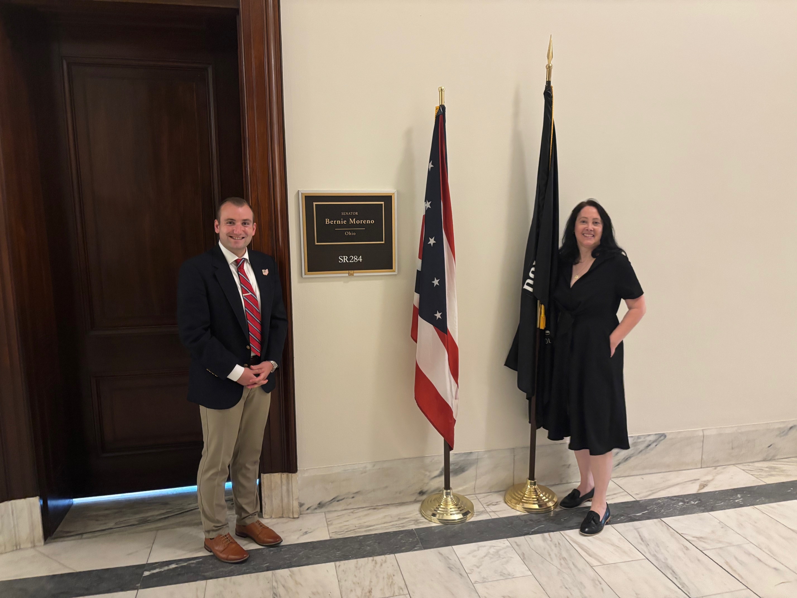
About the Boundless GR Team
Governmental Relations is housed in the Strategy Department at Boundless
The Strategy Team is led by Jennifier Riha, Chief Strategy Officer. Four departments are housed in the strategy department:
Governmental Relations, led by Anthony Kukura
Mergers and Acquisitions, led by Karen Carloni
Marketing and Communications, led by Elsa Warren
Business Development led by Jennifer Kerr
The Boundless GR department was officially formed in January of 2024
The department was a formal expansion of the GR operation/work Anthony started at Koinonia Homes prior to its merger with Boundless
Hailey Weaver is our current Governmental Affairs Intern

Slide 4

Why Engage in Governmental Relations Work?
Historically, our industry has not prioritized governmental affairs work, specifically at the state level. Our industry operated under the idea that we all just needed to make due with the funding we were given by the state, and occasionally engage in the budget process when absolutely essential
As a growing organization, and as the largest organization of our kind in the state, governmental affairs work has become a needed and essential function
Boundless has a duty and an obligation to engage in this process and be a leader in this work
Image Source: Michael Enzi - If you're not at the table, you're on the...

Slide 5

Organizational GR Philosophy
Boundless at its core is a mission driven, service minded, nonprofit organization. The individuals and the families Boundless serve have always remained the primary beneficiaries of our organizational resources.
Boundless has an obligation to engage in the policy process.
For a long time, our industry was not well represented at the table, and it shows how our issues have been prioritized in the past.
As Boundless continues to grow, strategic engagement with policy and decision makers is vital to ensuring the complex services we provide are properly understood.
Advocacy for the long term sustainability of our services, and our sector, is our cornerstone policy focus.
Image Source: https://www.pinterest.com/pin/grace-d-chin-on-instagram-shirley-chisholm-was-amazing-the-wikipedia-version-of-her-story-is-that-she-was-the-fi--48624870962962339/

Slide 6
Policy Goals and Accomplishments: 2025
Since the beginning of this year, the GR team has met with over 70 elected officials at the local, state, and federal level
Local Level: Our main goal for 2025 has been relationship building with local officials in the major cities and counties we current provide services within (Cuyahoga, Franklin, Lucas, Summit, & Montgomery). We have also sought to start to make some connections in Hamilton County give we foresee expansion in that region.
State Level: 2025 was a operating budget year for Ohio, so that has been our primary focus in state. Our goal this year was to ensure our rates for services were maintained at the historic levels passed in 2023 (the last state operating budget).
Federal Level: The budget reconciliation bill has dominated our federal level conversation thus far this year. Our goal was to ensure that the final version of the bill did not contain: Medicaid block grants, per-captia rates, or largescale FMAP changes.
Finding successes in a difficult legislative environment has been the theme of the year
Sometimes harm reduction is the best available policy "win"

Slide 7
Policy Goals- Looking Ahead: 2026 and Beyond
Local Level: Continuation of our relationship building with the major counties/ cities we operate within, while also looking for strategic partnership opportunities.
State Level: 2026 is a capital budget year for Ohio, so we foresee some engagement in that process. It will also be a time for us to engage with legislators for a variety of educational opportunities (site visits, OhioRise education, and Medicaid Dental provisions)
Federal Level: It still remains unclear what that legislative priorities are for the Congress for the remainder of this year and next. We are currently monitoring the Federal Budget negotiations, and any potential impact that legislation may have on our service lines. Additionally we foresee opportunities to discuss with lawmakers the continued need for an SOC for our DSPs, and continuing the conversation about the critical need for HCBS services
With 2026 being a Midterm Election year, this will likely overshadow much of our work at the state and Federal level. With a competitive environment likely both in-state and nationally, our strategy will remain fluid.
No set of political conditions lasts forever, and it is critical that this be acknowledged in long term GR planning

Slide 8

Boundless Advocates and Grassroots Advocacy
The Boundless Advocates is the grassroots arm of our organizational governmental affairs work
The group is made up of staff members, family members, individuals served, and other stakeholders
Our organization receives a significant amount of funds from governmental sources, making the need for engagement with elected leaders critical
In Ohio, the State Legislature has the sole authority to increase or decrease the rates for the services we provide
It makes a difference when elected leaders hear from their own constituents
Current our 142 advocates engage in activities including letter writing, testimony, and post card writing at the state and federal level
Since the beginning of this year, this group has generated nearly 500 touchpoints with elected leaders

Slide 9
Policy Goals- Looking Ahead: 2026 and Beyond
Local Level: Continuation of our relationship building with the major counties/ cities we operate within, while also looking for strategic partnership opportunities.
State Level: 2026 is a capital budget year for Ohio, so we foresee some engagement in that process. It will also be a time for us to engage with legislators for a variety of educational opportunities (site visits, OhioRise education, and Medicaid Dental provisions)
Federal Level: It still remains unclear what that legislative priorities are for the Congress for the remainder of this year and next. We are currently monitoring the Federal Budget negotiations, and any potential impact that legislation may have on our service lines. Additionally we foresee opportunities to discuss with lawmakers the continued need for an SOC for our DSPs, and continuing the conversation about the critical need for HCBS services
With 2026 being a Midterm Election year, this will likely overshadow much of our work at the state and Federal level. With a competitive environment likely both in-state and nationally, our strategy will remain fluid.
No set of political conditions lasts forever, and it is critical that this be acknowledged in long term GR planning

